Slide 1
Clustering The Automotive
Yang Runkang, Tao Panxin, Bu zhuoyang
{yangrk2022,taopx2022,buzy2022}@shanghaitech.edu.cn

Slide 2

Table of Contents
Background
Introduction
Methodology
Feature Engineering
Dimensional Reduction
Clustering
Results
Q&A

Slide 3
Table of Contents
Background
Introduction
Methodology
Feature Engineering
Dimensional Reduction
Clustering
Results
Q&A

Slide 4

Background…
In the competitive automotive market, understanding vehicle groupings provides critical insights for strategic decisions like pricing and product positioning.
Cat Pusheen processed high-dimensional vehicle data using dimensionality reduction methods, then applied K-means and hierarchical clustering to group vehicles based on shared attributes.
By analyzing the clusters, Pusheen identified competing models for VW, providing actionable insights to support data-driven decision-making in the automotive industry.
I am hesitating to buy Volkswagen

Slide 5
Table of Contents
Background
Introduction
Methodology
Feature Engineering
Dimensional Reduction
Clustering
Results
Q&A

Slide 6

Introduction
Problem SetUp:
https://tianchi.aliyun.com/competition/entrance/531892/information
Objectives:
find competitor for Volkswagen
Dataset:
car_price.csv
Methodology:
2 dim reduction methods (PCA/AE)
2 clustering methods (K-means/Hierarchical)
A well-defined problem!

Slide 7
Table of Contents
Background
Introduction
Methodology
Feature Engineering
Dimensional Reduction
Clustering
Results
Q&A

Slide 8
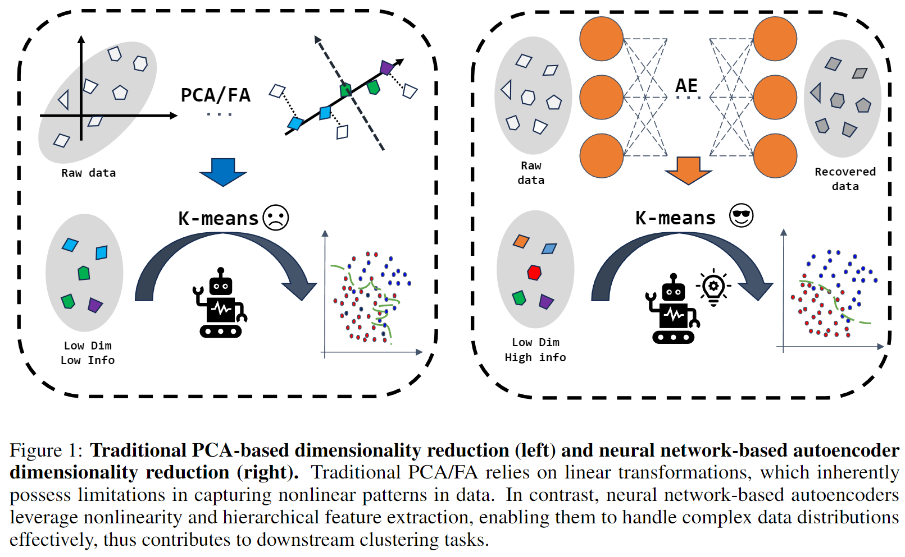
Methodology Overview

Slide 9
Table of Contents
Background
Introduction
Methodology
Feature Engineering
Dimensional Reduction
Clustering
Results
Q&A

Slide 10

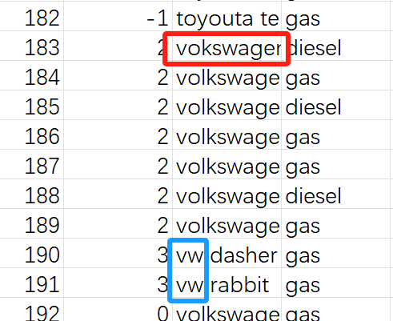
Feature Engineering
Data cleaning
Spelling error:
Correct invalid entries
Missing value:
Use mean, median, mode, or interpolation
Removing duplicates:
Drop exact duplicate rows
Data format:
Unify unit/format
Vokswagen is not Volkswagen !

Slide 11
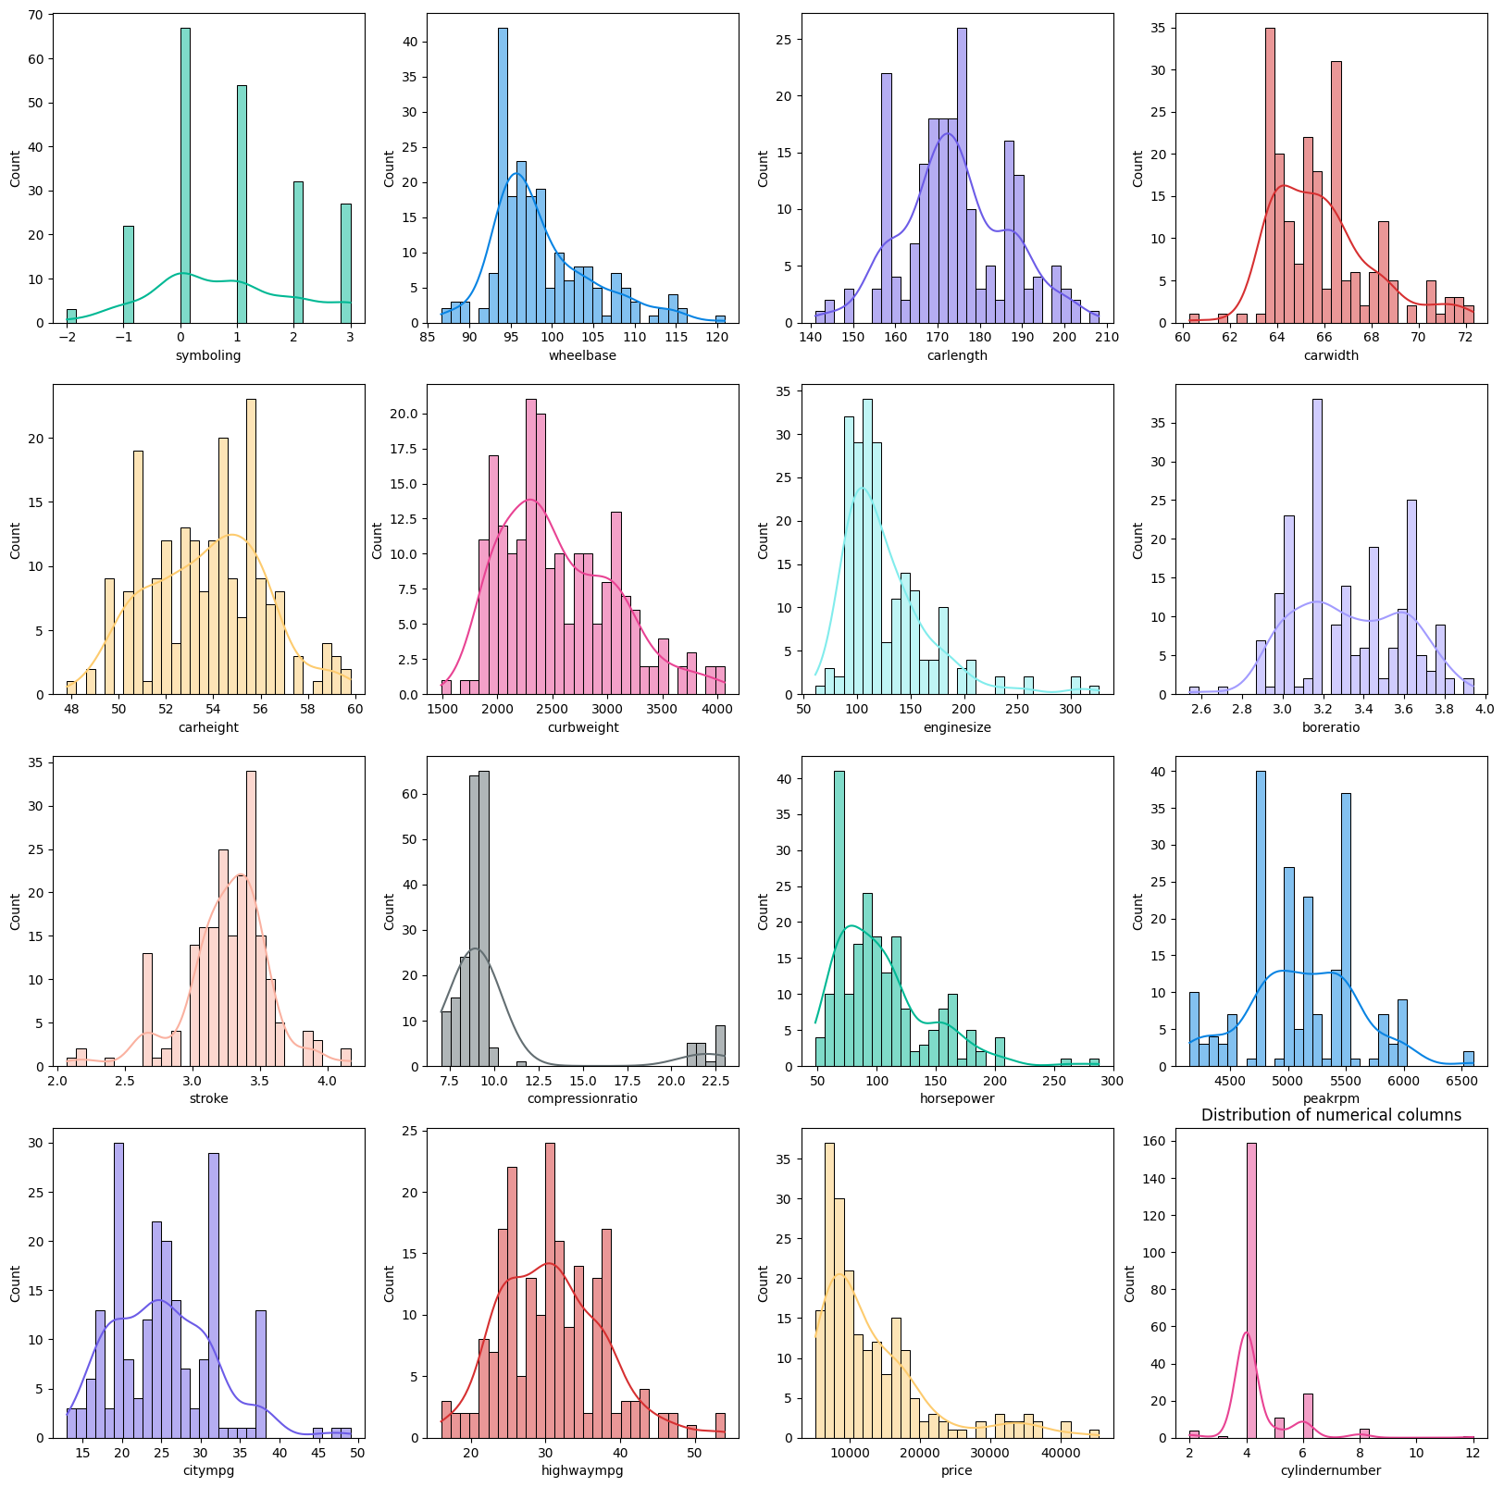
Feature Engineering
Data distribution: numerical feature histogram 📊

Slide 12
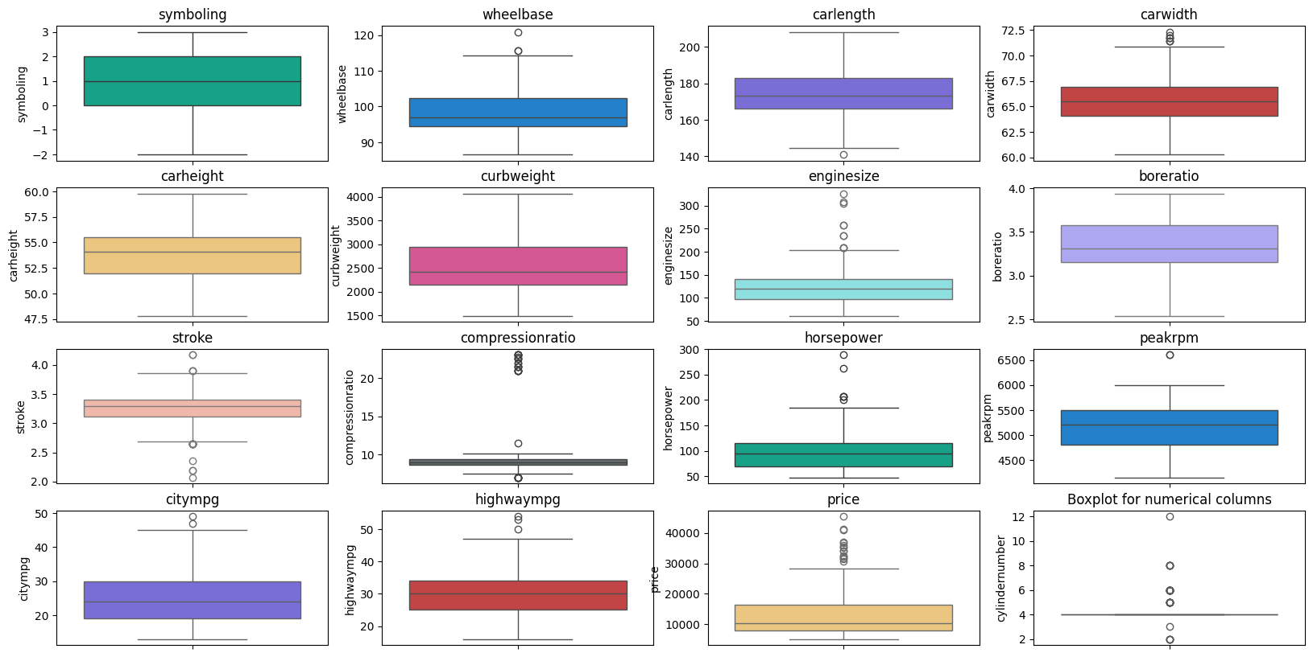

Feature Engineering
Outlier Detection: boxplots
Handling: filter through z-score
Visualization is all you need!

Slide 13
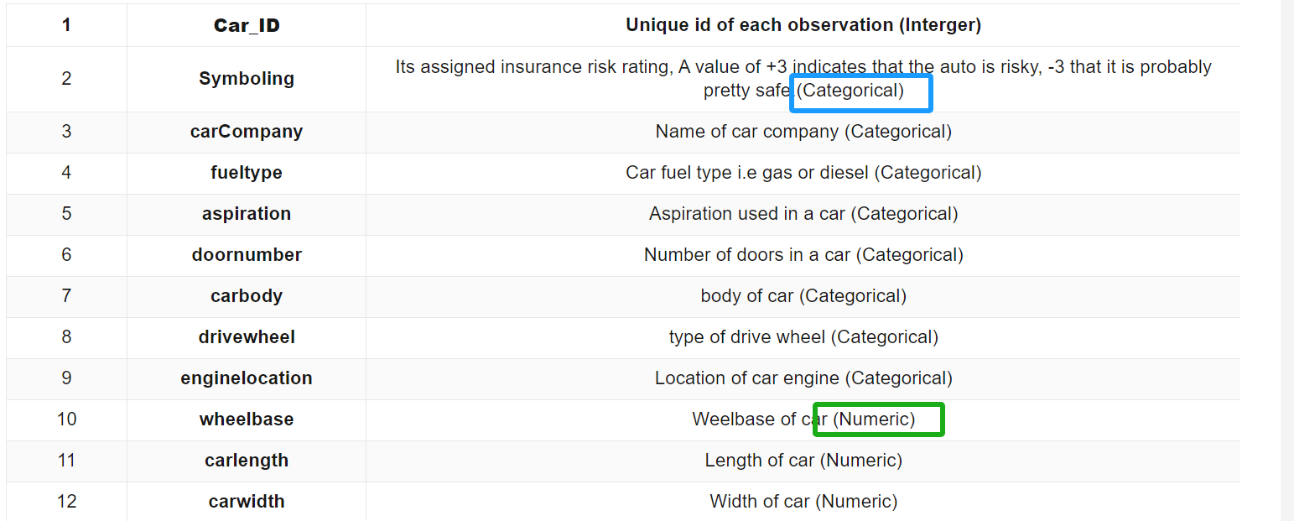
Feature Engineering
Normalization of numerical feature:
eliminate the influence of different scales
normalized using the MinMaxScaler()
One-hot encoding of categorical variables:
encoded as a binary vector
Why one-hot?
if C = {convertible, hatchback,sedan}
convertible = [1, 0, 0],
hatchback = [0, 1, 0],
sedan = [0, 0, 1]

Slide 14
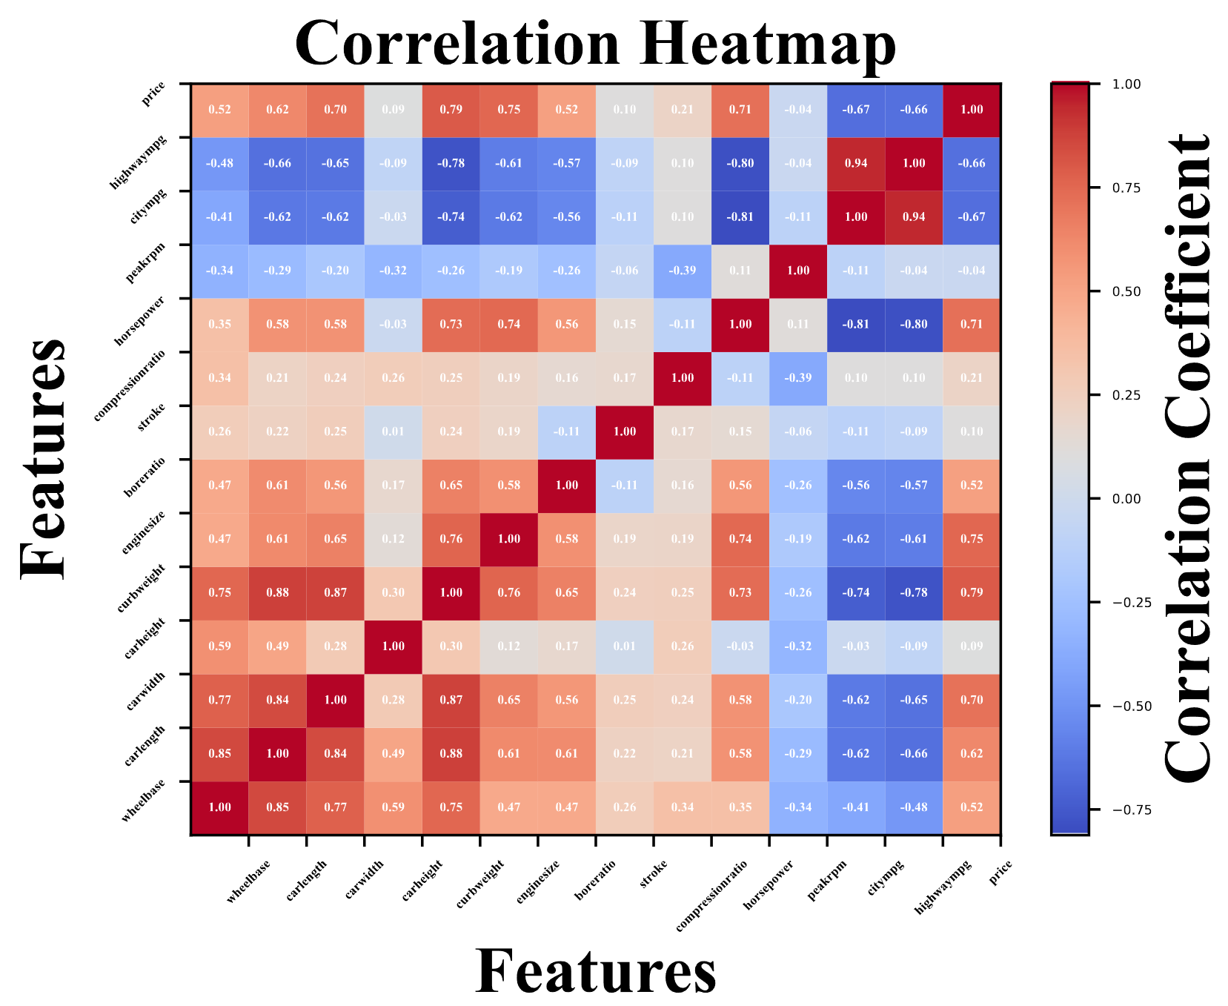

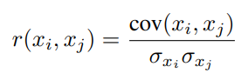
Feature Engineering
Feature selection:
identify the most relevant features for clustering
filter by |r|>0.85
Numerous features, let’s filter!

Slide 15
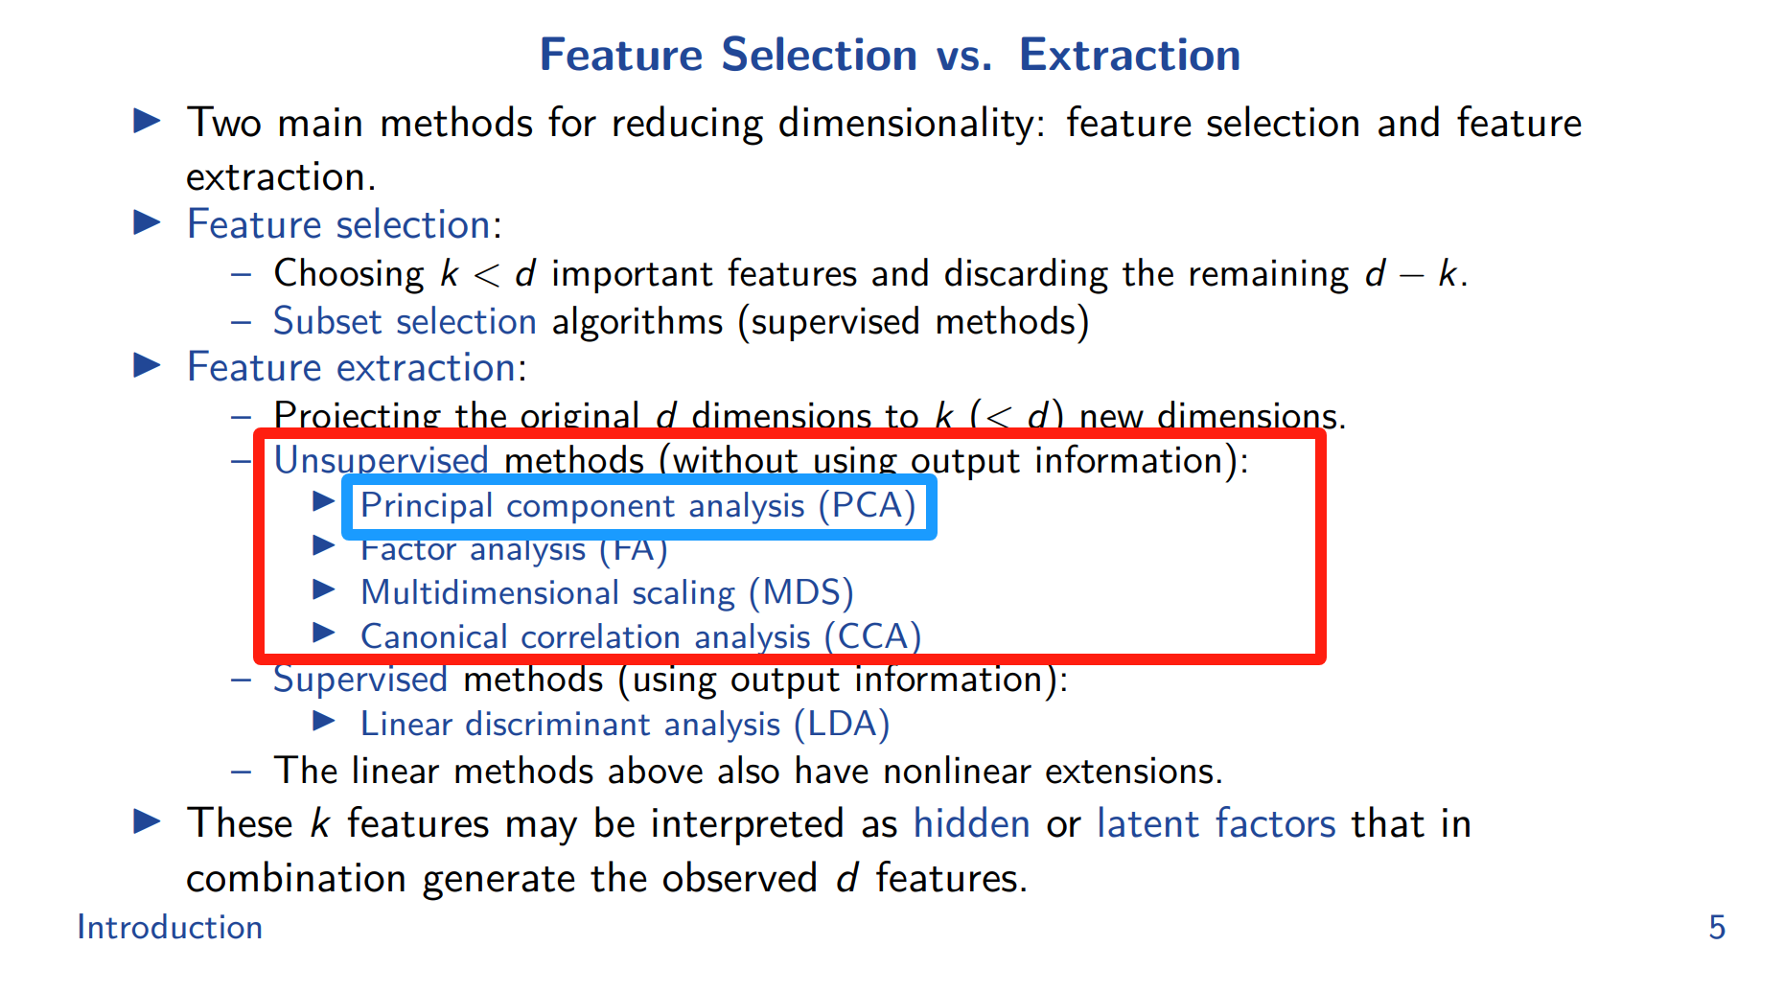
Table of Contents
Background
Introduction
Methodology
Feature Engineering
Dimensional Reduction
Clustering
Results
Q&A

Slide 16
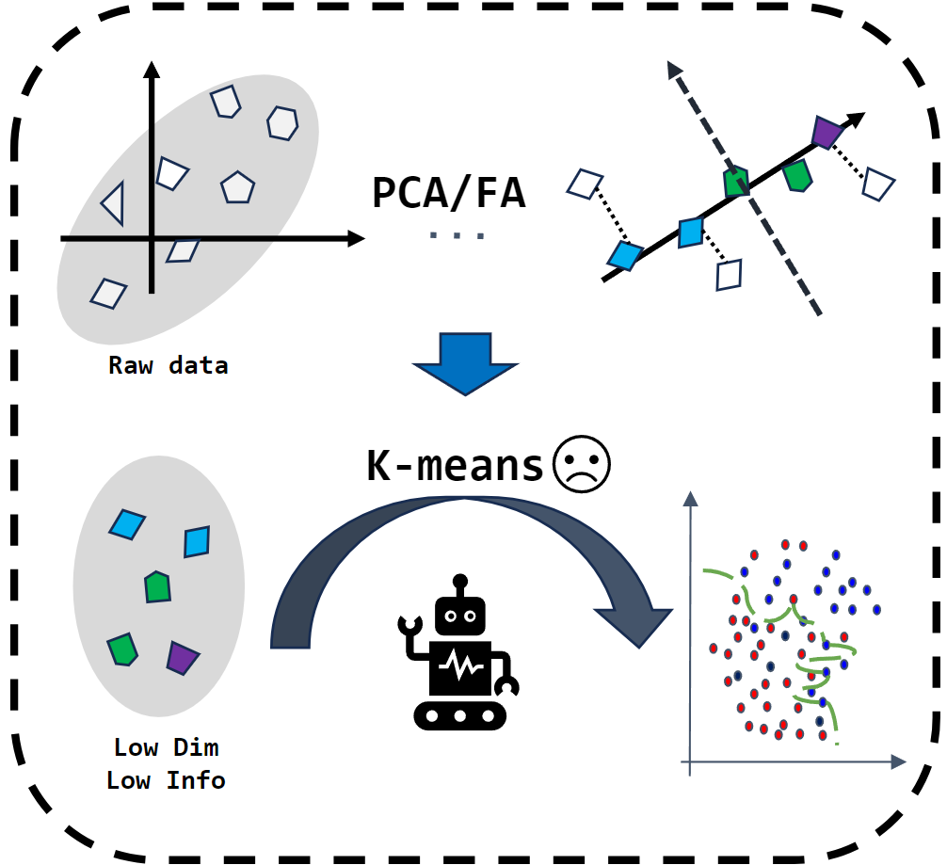
Dimensional Reduction
Principal Component Analysis
Pros & Cons:
✅ Pros:
Reduces dimensions effectively.
Decreases overfitting and computation.
Transforms features into uncorrelated components.
❌ Cons:
Lacks interpretability.
Loses some variance.
Assumes linearity.
Sensitive to feature scaling.

Slide 17
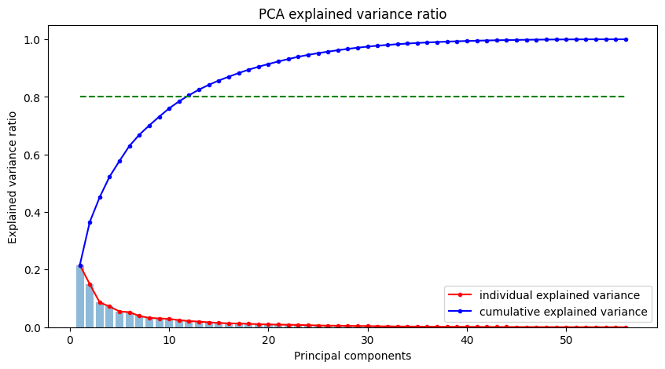
Dimensional Reduction

Slide 18
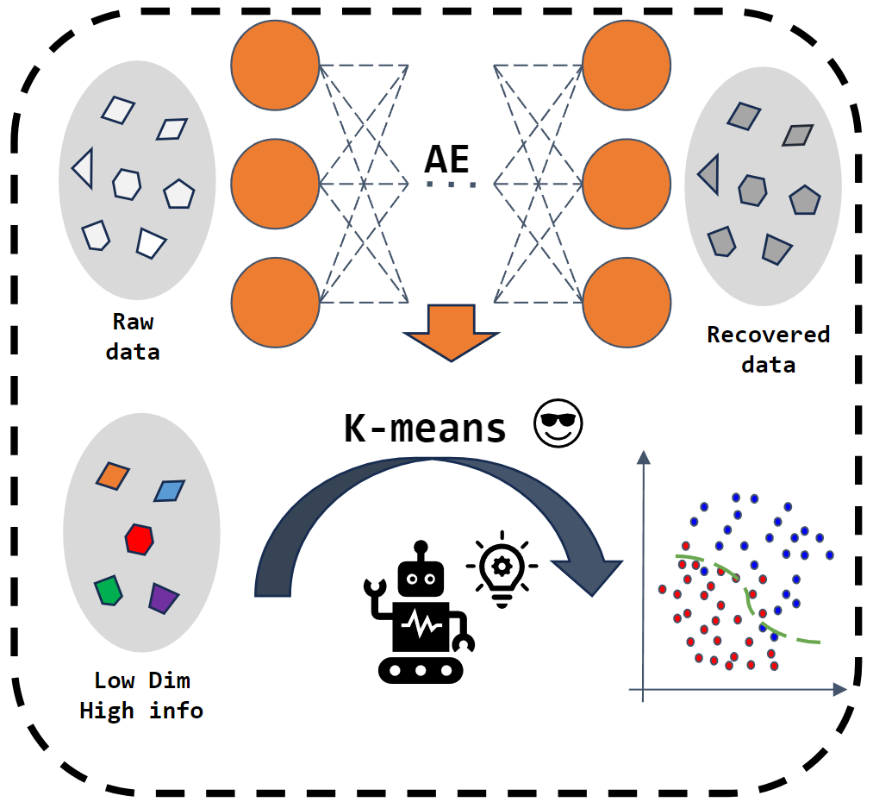
Dimensional Reduction
Pros & Cons:
✅ Pros:
Handles nonlinear relationships effectively.
Learns data-specific and robust representations.
Customizable architecture for different tasks.
❌ Cons:
Requires large datasets for training.
Computationally expensive to train.
May not generalize well to unseen data.
Less interpretable compared to PCA.
Auto encoder

Slide 19
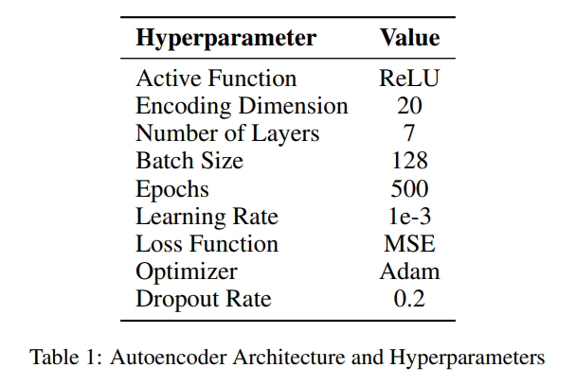
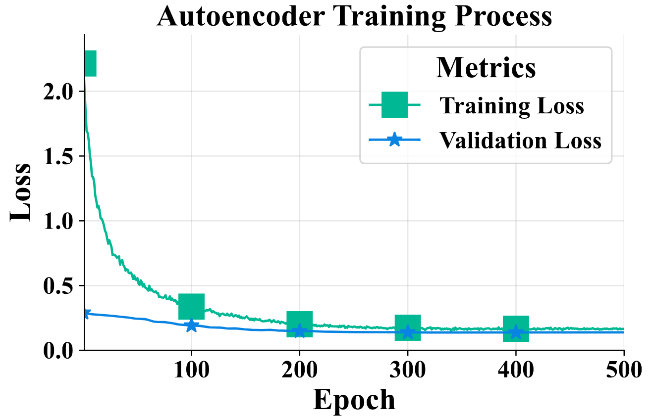
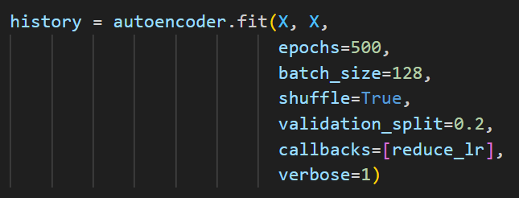

Dimensional Reduction
Let’s start training and waiting…waiting…

Slide 20
Table of Contents
Background
Introduction
Methodology
Feature Engineering
Dimensional Reduction
Clustering
Results
Q&A

Slide 21
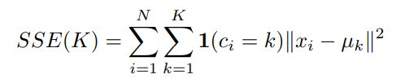
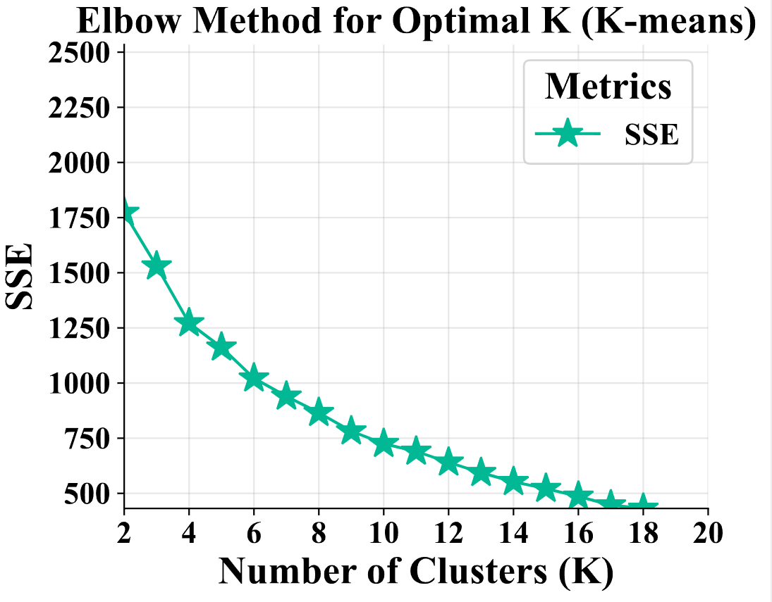
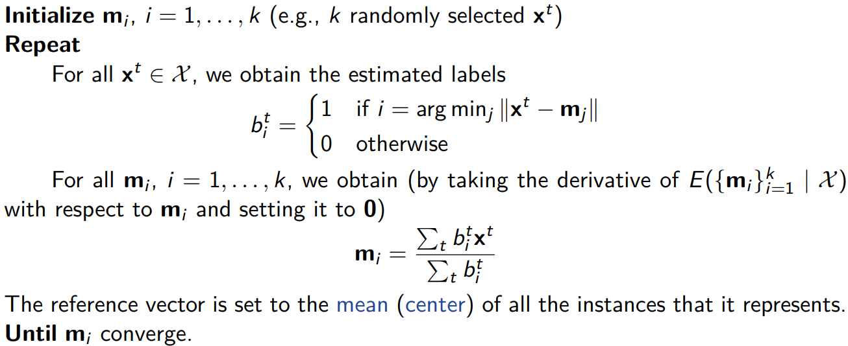
Clustering
K-means Clustering:
Minimize within-cluster sum of squared errors (SSE):
Algorithm:

Slide 22
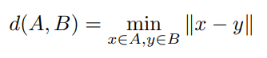
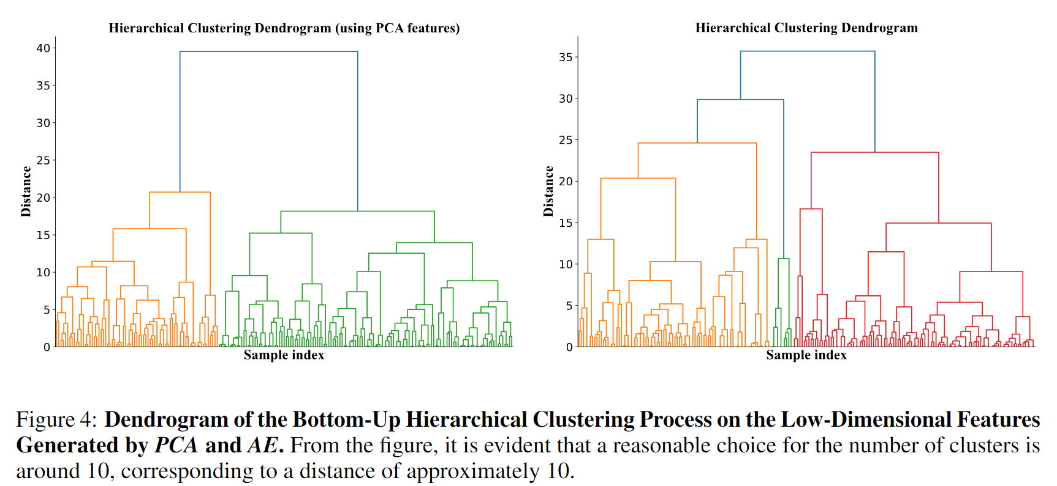

Clustering
Hierarchical Clustering:
iteratively merging smaller clusters (agglomerative)
Endless iterations…

Slide 23
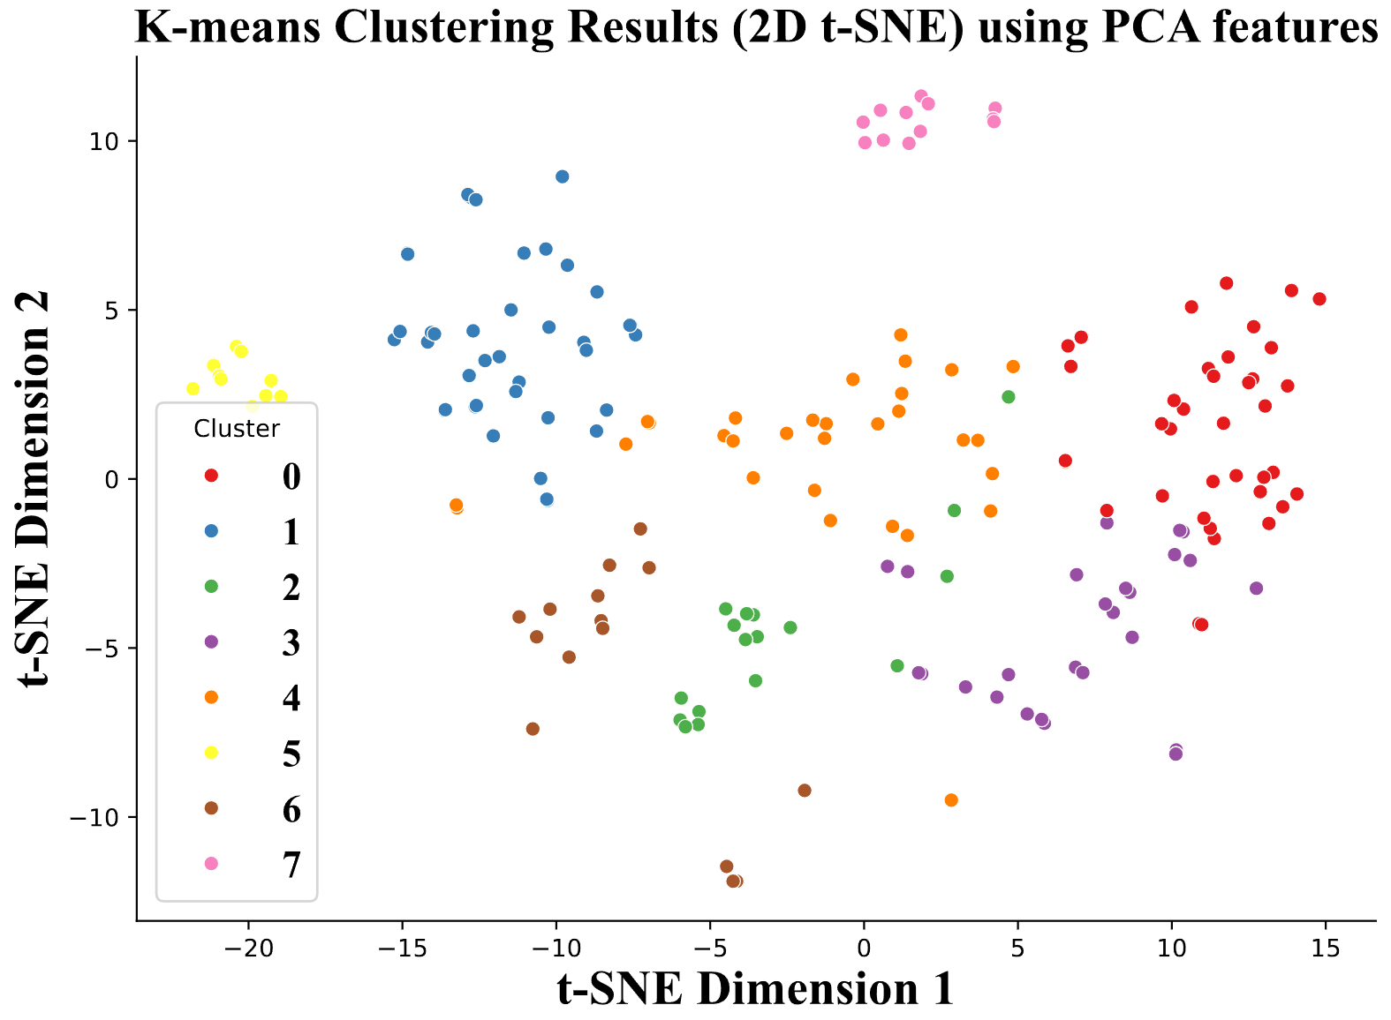
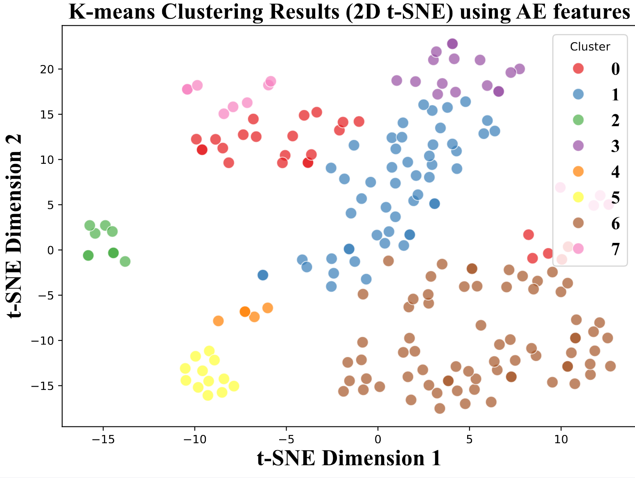
Clustering
K-means Visualization:

Slide 24
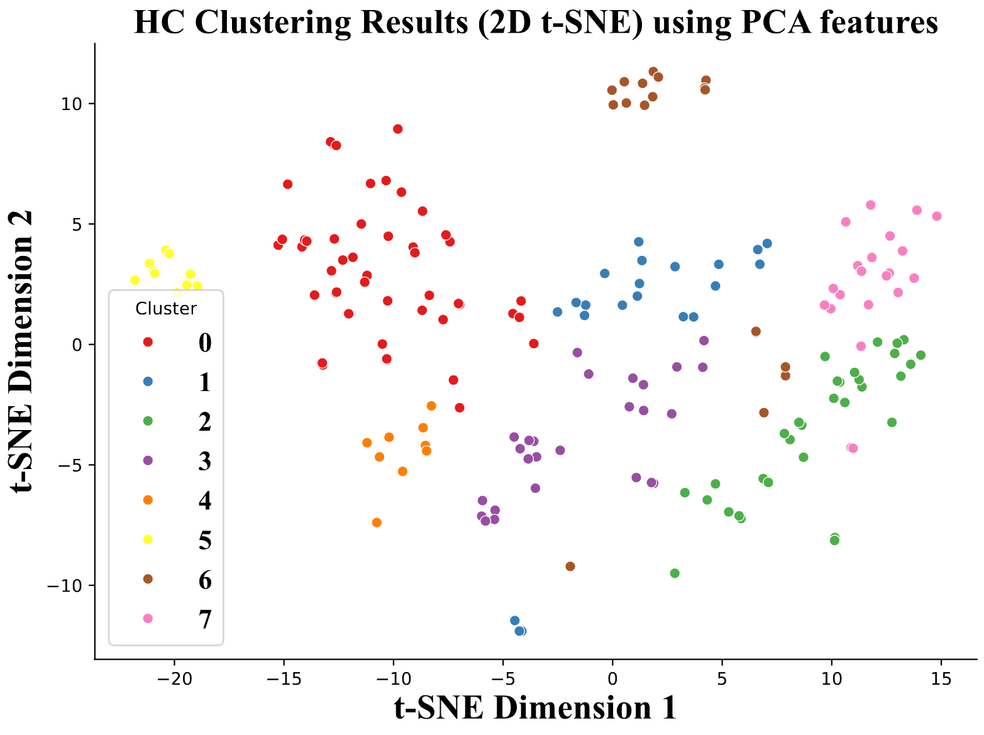
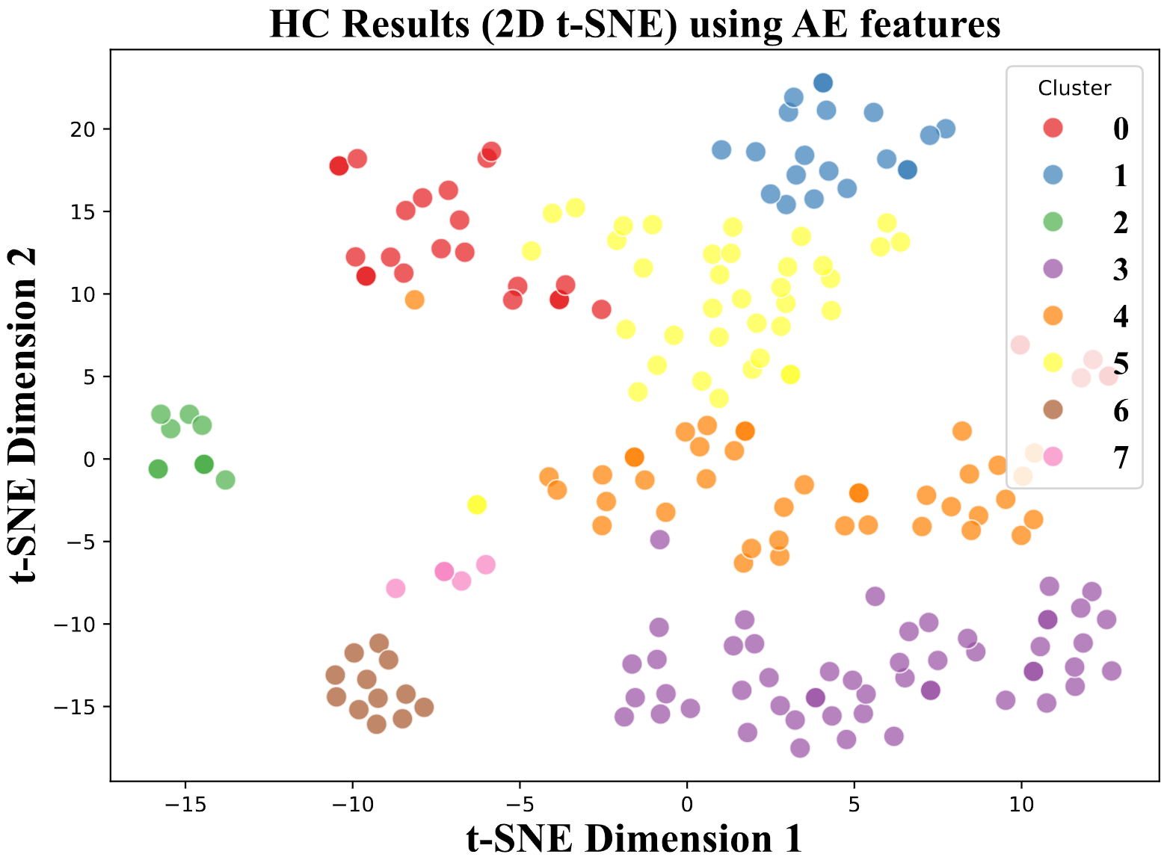
Clustering
Hierarchical Clustering Visualization:

Slide 25
Table of Contents
Background
Introduction
Methodology
Feature Engineering
Dimensional Reduction
Clustering
Results
Q&A

Slide 26
Numerical Results
Evaluation Metric For Clustering:
Silhouette Score:
Combines intra-cluster cohesion and inter-cluster separation; higher is better.
CH Score:
Ratio of between-cluster to within-cluster dispersion; higher is better.
DB Score:
Average ratio of intra-cluster scatter to inter-cluster separation; lower is better.
Dunn Index:
Ratio of minimum inter-cluster distance to maximum intra-cluster distance; higher is better.

Slide 27
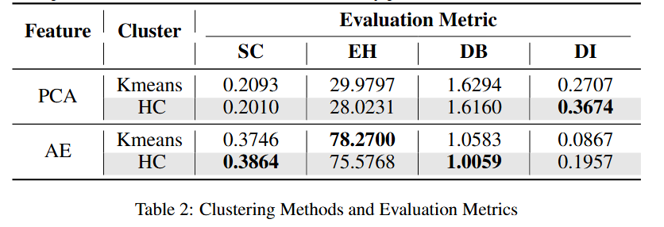

Numerical Results
Numerical Results:
Is it compact enough?

Slide 28
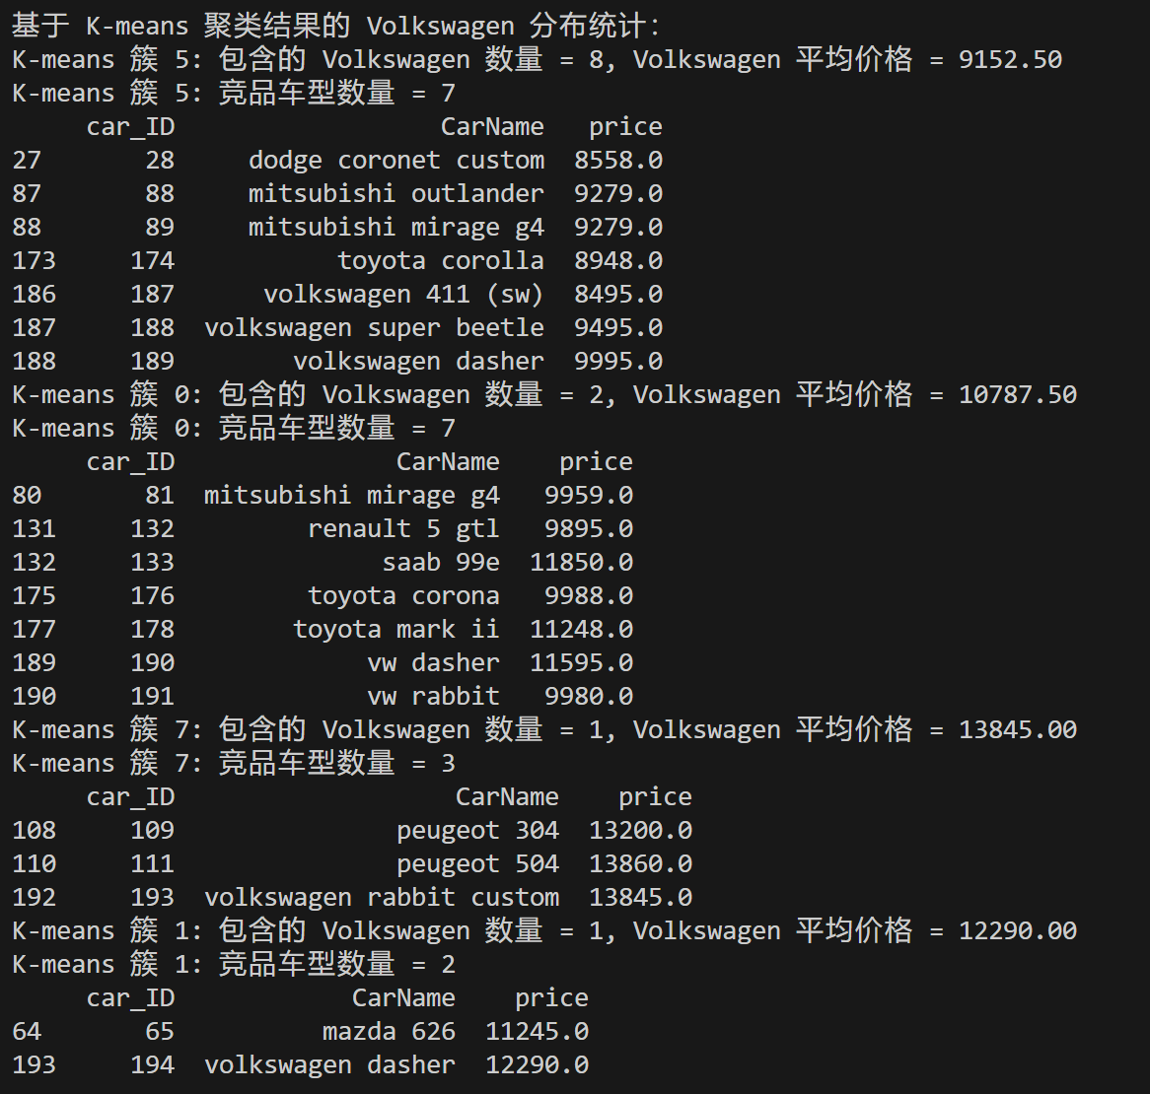
Numerical Results
Analysis:
Choose competitor within the cluster
VM price median ± 10%

Slide 29
Thanks！

